Slide 1

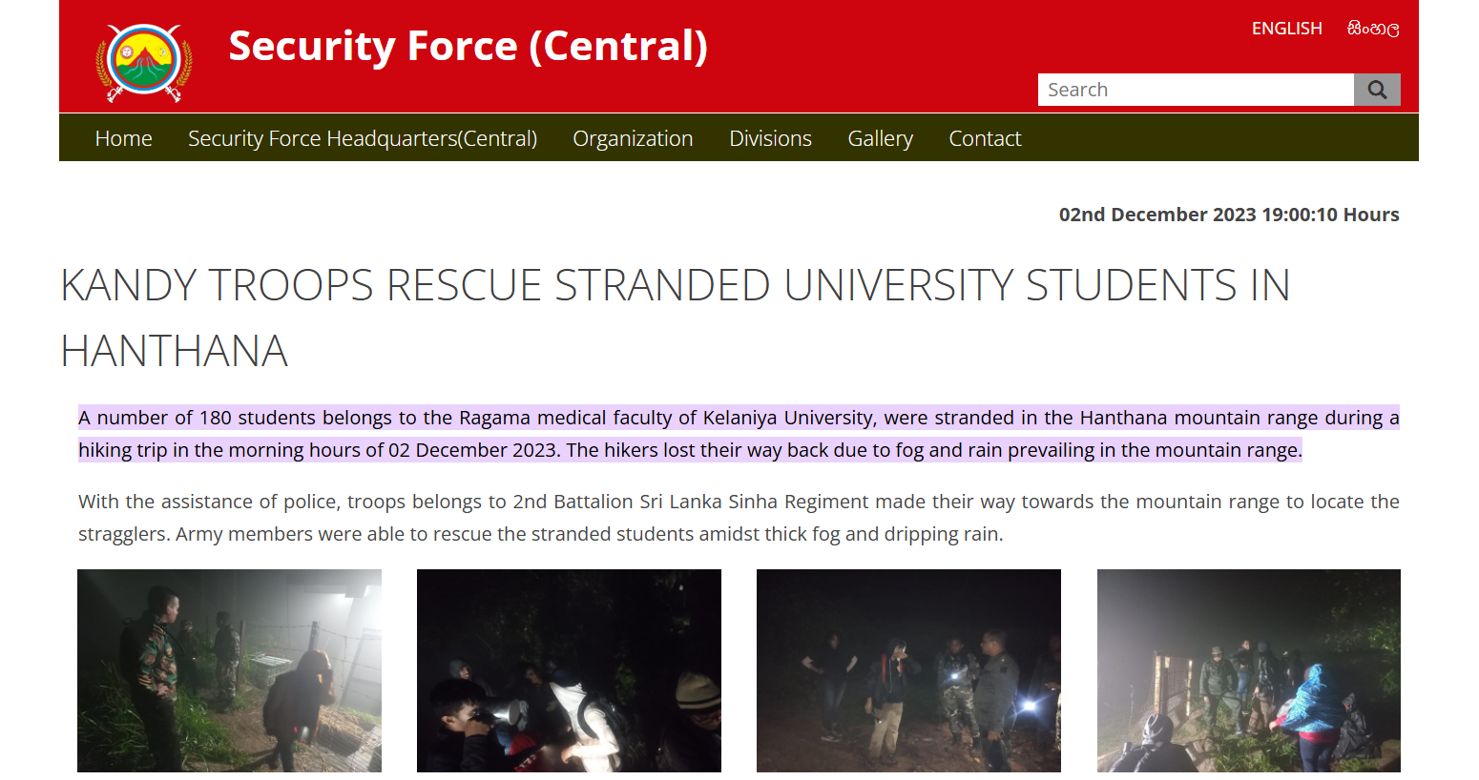
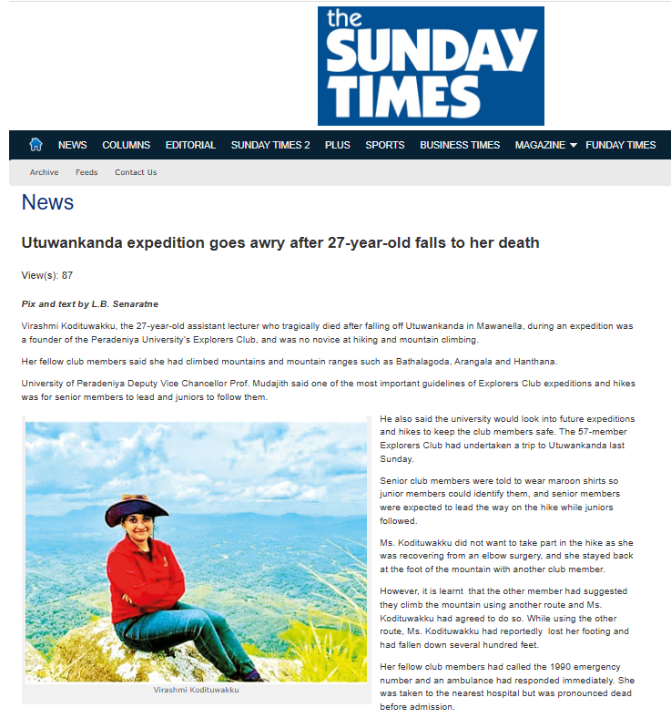
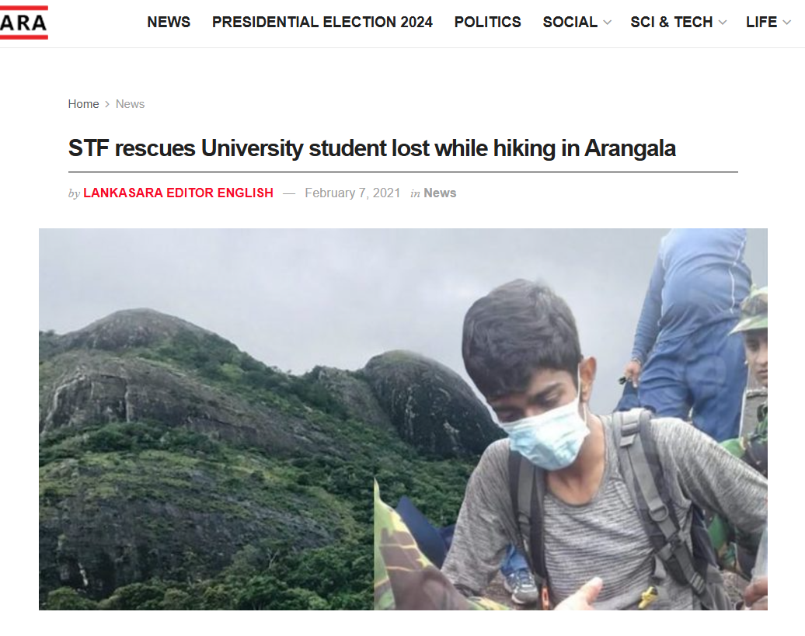

Slide 2
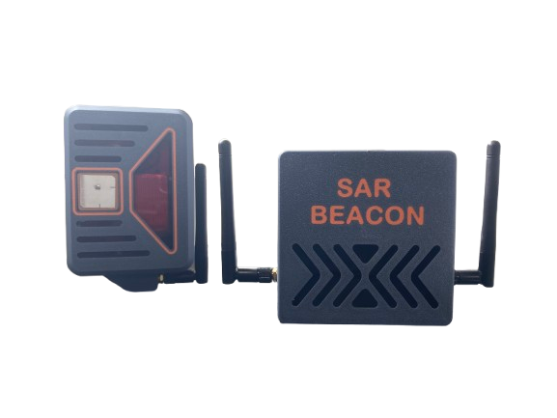
SAR Beacon
An IoT-based Search and rescue Device
BSc in Electronics and Automation Technologies University of Colombo 22sea028

Slide 3

01
Introduction
Safety for trekkers in remote areas is a challenge.
SAR Beacon provides a solution using IoT technology to ensure safety through real-time tracking and alerts.
Notes:
Good morning, everyone.
Let me begin with a question: How often have we heard of lives lost in remote areas simply because help couldn’t arrive in time?
For trekkers, adventurers, and first responders, safety in remote regions remains a persistent challenge. This is where our innovation, SAR Beacon, steps in. SAR Beacon is an IoT-based search and rescue device designed to ensure safety through real-time location tracking, health monitoring, and emergency alert systems. Today, I’ll walk you through how this device works, its design, and the impact it promises to create.

Slide 4
Objectives
02
Develop a system to monitor trekkers' location and health conditions.
Provide long-distance communication via LoRa.
Enable real-time monitoring and emergency alerts.
Notes:
Our primary objectives with SAR Beacon are threefold:
Real-Time Monitoring – To keep track of the location and health conditions of individuals in remote environments.
Long-Distance Communication – Utilizing LoRa technology to overcome the communication barriers in areas with no cellular coverage.
Emergency Alerts – To enable immediate action when critical health or safety thresholds are breached.
These goals guide every technical decision in the project, from component selection to system architecture.

Slide 5

Hardware Design
Electronics &
Automation
Technologies
03
Transmitter: ESP32, LoRa RA-02, Neo 6M GPS, MAX30100, LiPo battery.
Receiver: ESP32, LoRa RA-02, SIM7600, LiPo battery.
Compact, portable design with efficient power management.
Notes:
The hardware behind SAR Beacon reflects the need for reliability, portability, and efficiency:
Transmitter Unit: Built around the ESP32 microcontroller, it incorporates a LoRa RA-02 module for communication, a Neo-6M GPS for location data, and a MAX30100 sensor for health metrics like heart rate and blood oxygen saturation. Power is supplied by a lightweight LiPo battery, ensuring portability.
Receiver Unit: Similarly equipped with an ESP32 and LoRa RA-02, it adds a SIM7600 module for internet connectivity. This unit ensures seamless data transfer to the cloud while maintaining low power consumption.

Slide 6
Working Process
04
Transmitter collects GPS and health data (heart rate, SpO2).
Data sent to receiver using LoRa communication.
Receiver uploads data to Firebase for real-time access.
Abnormal health conditions trigger SMS alerts.
Electronics &
Automation
Technologies
Notes:
How does SAR Beacon function? Let me break it down:
Data Collection: The transmitter gathers GPS coordinates and vital signs.
Communication: Using LoRa, the data is sent to the receiver, ensuring reliable transmission over long distances, even in the absence of cellular networks.
Cloud Integration: The receiver uploads this data to Firebase, making it accessible in real time via a web or mobile interface.
Alerts: If abnormal health conditions, such as irregular heart rates or low oxygen levels, are detected, the system automatically sends an SMS to predefined emergency contacts.
This streamlined workflow ensures that critical data reaches rescuers or family members in a timely manner, potentially saving lives.

Slide 7
Applications
05
Safety for trekkers and adventurers.
Rescue operations in remote areas.
Potential for other safety-critical domains.
Notes:
SAR Beacon’s applications extend far beyond trekking or adventure sports. It can become a critical tool for:
Rescue operations in disaster-hit areas.
Enhancing safety in remote industrial sites, such as mining or forestry.
Military use in inaccessible terrains.
By addressing these diverse needs, SAR Beacon positions itself as a versatile solution for safety-critical domains.

Slide 8
06
Challenges & Solutions
LoRa range limitations → change the settings of transceivers.
Power efficiency → Power management techniques.
Health monitoring accuracy → Sensor calibration.
Notes:
Of course, every innovation comes with its share of challenges. For SAR Beacon, these included:
LoRa Range Limitations: We optimized transceiver settings to extend communication range effectively.
Power Management: By employing advanced techniques such as sleep modes, we significantly improved battery efficiency.
Health Monitoring Accuracy: Through careful calibration of the MAX30100 sensor, we ensured reliable readings for critical health metrics.
These solutions highlight our commitment to making SAR Beacon a dependable device in real-world scenarios.

Slide 9
07
Future Enhancements
Enable bi-directional communication for SOS requests.
Integration with satellite communication for better coverage.
Improved wearability and ergonomics.
Notes:
Looking ahead, we envision significant upgrades to SAR Beacon:
Bi-Directional Communication: Allowing users to send SOS requests or updates in emergencies.
Satellite Integration: Expanding coverage to the most remote corners of the globe.
Improved Wearability: Enhancing comfort and usability for diverse users.
These enhancements aim to make SAR Beacon not just a device but a comprehensive solution for personal safety in remote environments.

Slide 10
Conclusion
08
SAR Beacon ensures trekkers' safety using IoT, GPS, and real-time health monitoring.
Long-distance communication via LoRa.
Real-time alerts for abnormal conditions.
Potential impact on safety and rescue operations.
Notes:
In summary, SAR Beacon combines the power of IoT, GPS, and health monitoring to revolutionize safety for trekkers and adventurers. With its ability to provide long-distance communication and real-time alerts, it holds immense potential to transform rescue operations and other safety-critical applications.
Imagine a future where no life is lost due to delayed help, where technology bridges the gap between danger and rescue. That’s the future SAR Beacon is striving to create.

Slide 11
Thank you !
Notes:
Thank you, and I am happy to answer any questions.

